Slide 1
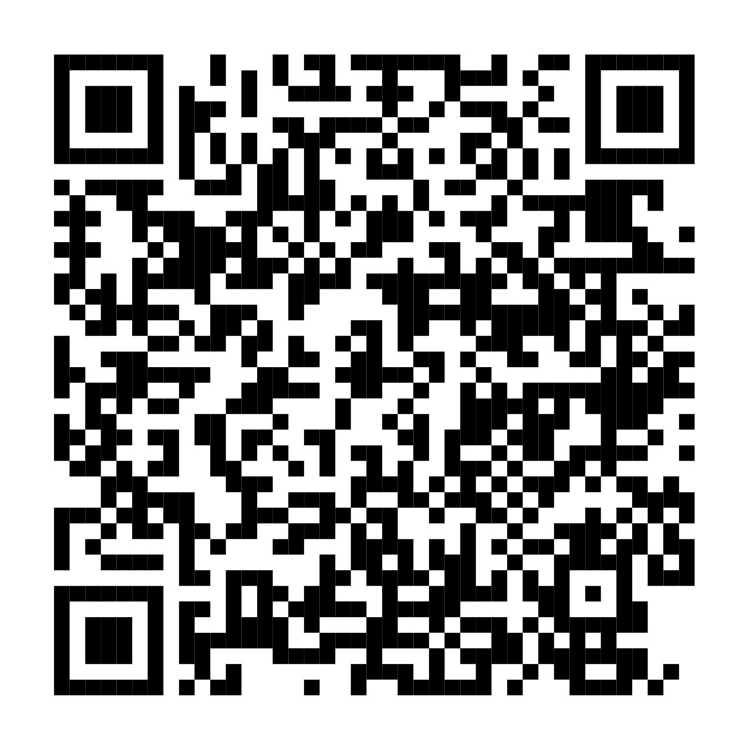
Annual Enrollment is almost here. It’s time to review your benefits.
Your Annual Enrollment window is
<AE START DATE> until <AE END DATE>.
Now’s a great time to check your selections and make sure they fit your life. NetBenefits® will soon have everything you need to help you compare and enroll. You’ll also find personalized guidance to help you get the most from your benefits.
Scan to enroll or visit www.NetBenefits.com/healthbenefits
Fidelity Brokerage Services LLC, Member NYSE, SIPC, 900 Salem Street, Smithfield, RI 02917 © 2025 FMR LLC. All rights reserved. XXXXXX.X.0
CLIENT LOGO

